Slide 1
Can you beat the average?
A compact carbon comparison app

Slide 2
One Planet Living

Slide 3

Carbon emissions calculator
We wanted to make an app for calculating how many planets the user would use, but realised this would be quite negative as an app.
Instead, we decided to make it into a game, by comparing against the user’s country’s average emissions.

Slide 4
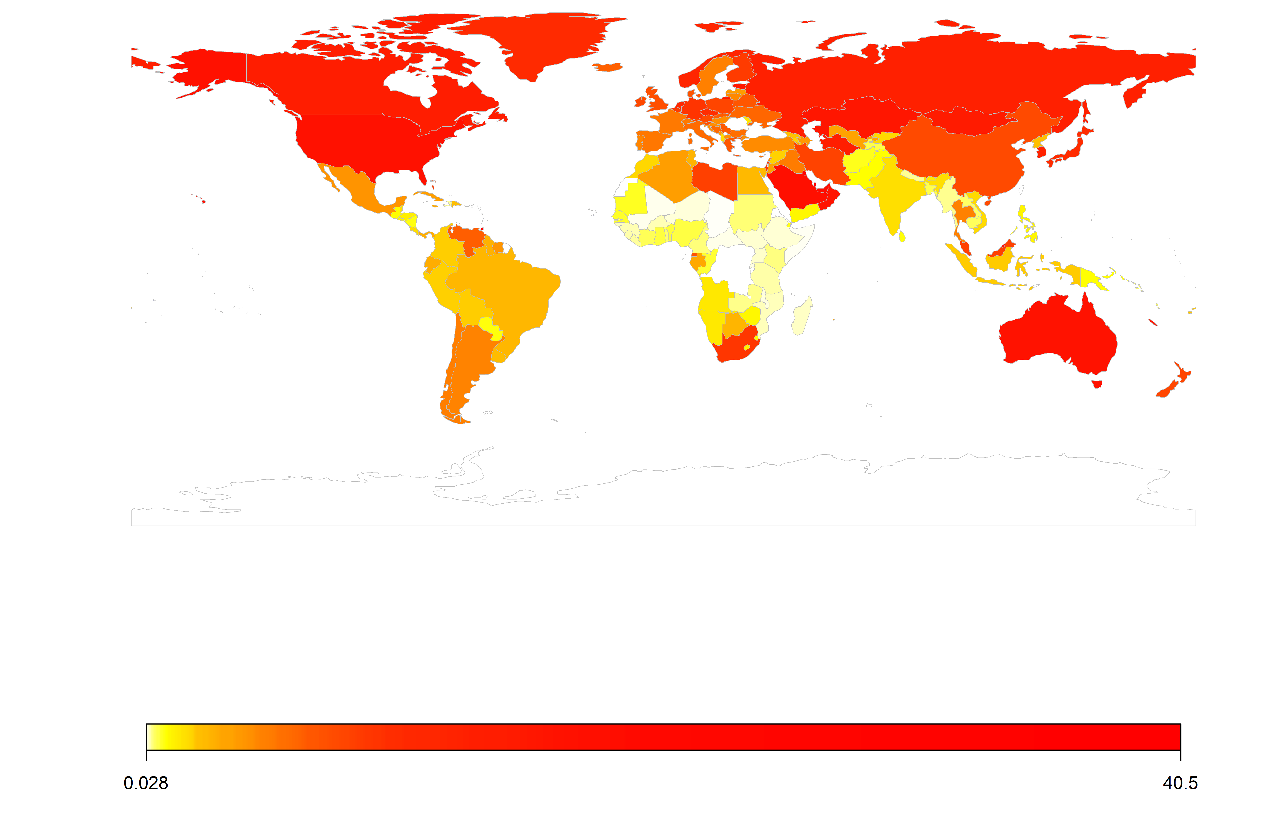
Per capita emissions data
Source: http://databank.worldbank.org/data/reports.aspx?source=2&series=EN.ATM.CO2E.PC&country=#

Slide 5
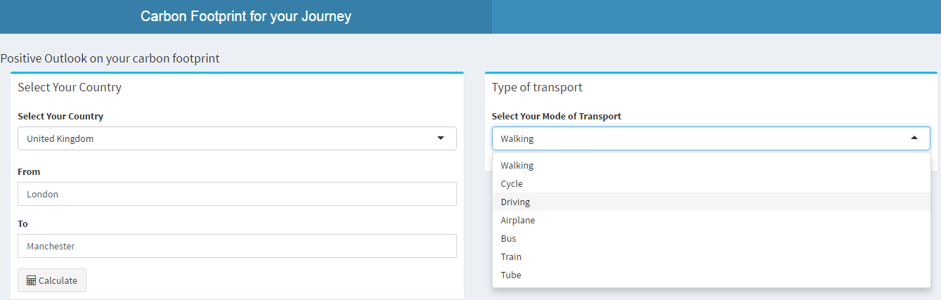
The (shiny) app

Slide 6
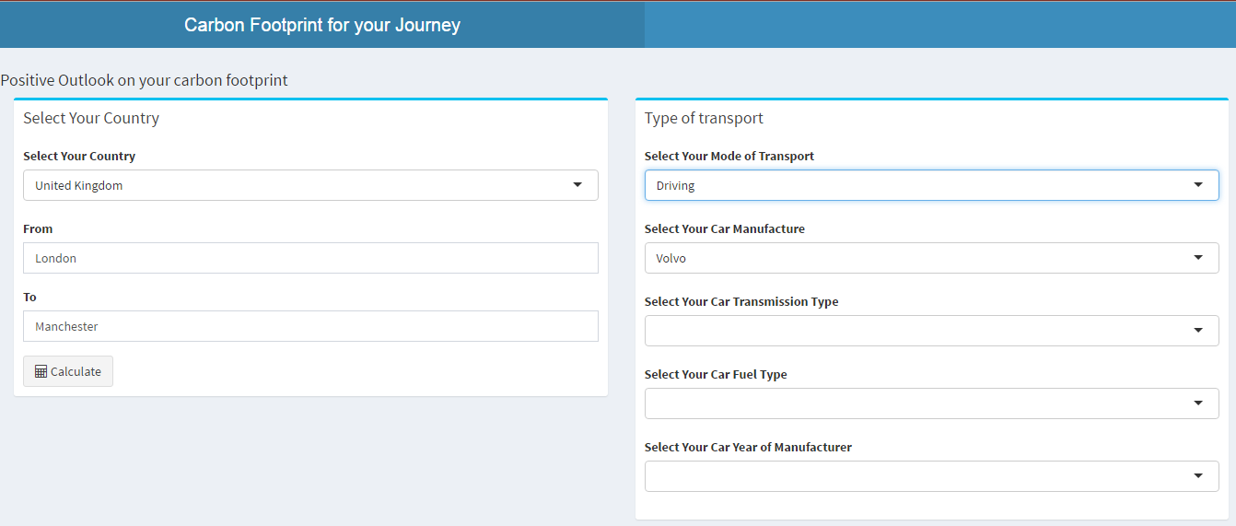
The (shiny) app

Slide 7
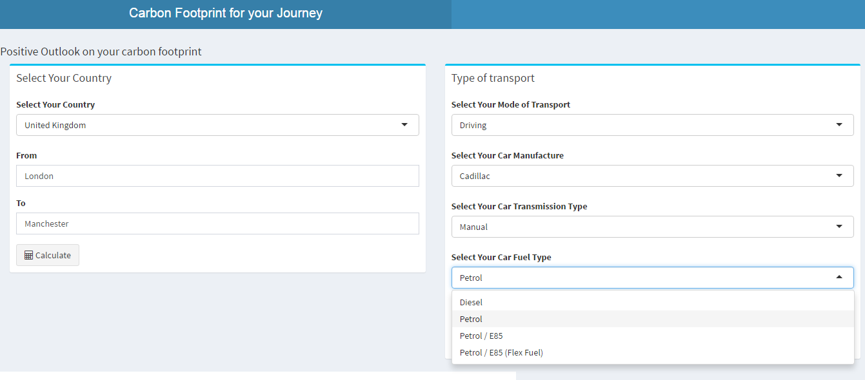
The (shiny) app

Slide 8
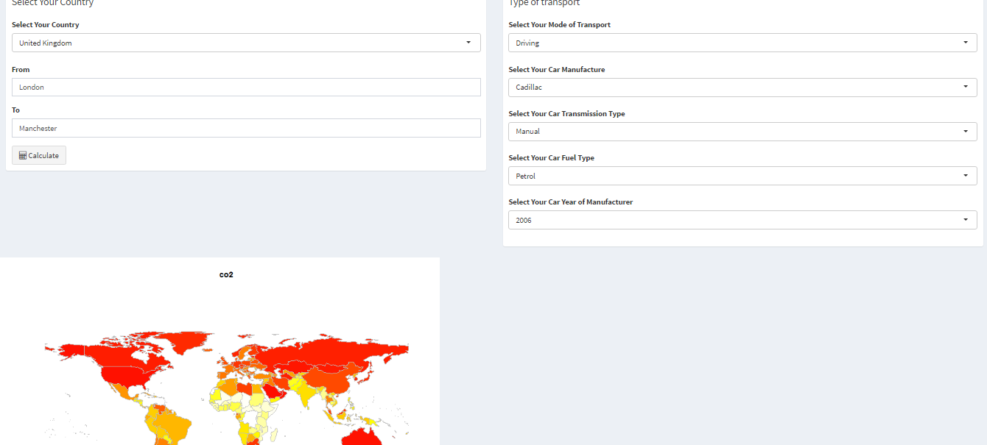
The (shiny) app

Slide 9
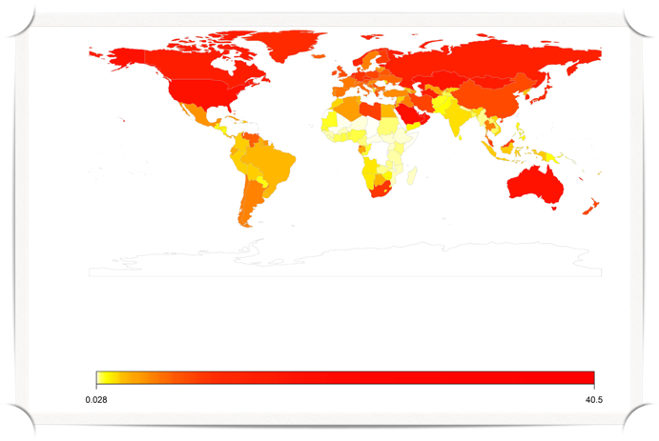


Output
Above average!

Slide 10

Output
Below average!

Slide 11
Other factors to consider
(Approximately static) yearly emissions from household gas and electricity usage.
Food miles
Wastage

